Slide 1
Deciding Best Place to Open New Shopping Centre in Mumbai , India
IBM Applied Data Science Capstone
By : Mayur Rindhe
August , 2019

Slide 2
Business Problem :
The objective of this capstone project is to analyse and select the best locations in the city of Mumbai , Maharashtra (India) to open a new shopping Centre.
Using data science methodology and machine learning techniques like clustering also using web scrapping , this project aims to provide solutions to answer the business question: In the city of Mumbai , India if a property developer , builders , foreign investors are looking to open a new shopping Centre, where would you recommend that they open it?
Business question :
In the city of Mumbai , if the property developer is looking to open a new shopping centre , where would you recommend that they open it ?

Slide 3
Data :
Data Required :
List of neighbourhoods in Mumbai city.
Latitude and longitude coordinates of those neighbourhoods.
Venue data, particularly data related to shopping Centres.
Sourcrs of data :
https://en.wikipedia.org/wiki/Category:Neighbourhoods_in Mumbai
Geocoder package is used to get the latitude and longitude
Foursquare API to get the venue data .

Slide 4
Methodology :
Web scraping Wikipedia page for neighbourhoods list
Using geocoder get the latitude and longitude of places
Use Foursquare API to get venue data
Group data by neighbourhood and taking the mean of the frequency of occurrence of each venue category
Filter venue category by Shopping Centre
Perform clustering on the data by using k-means clustering
Visualize the clusters in a map using Folium

Slide 5
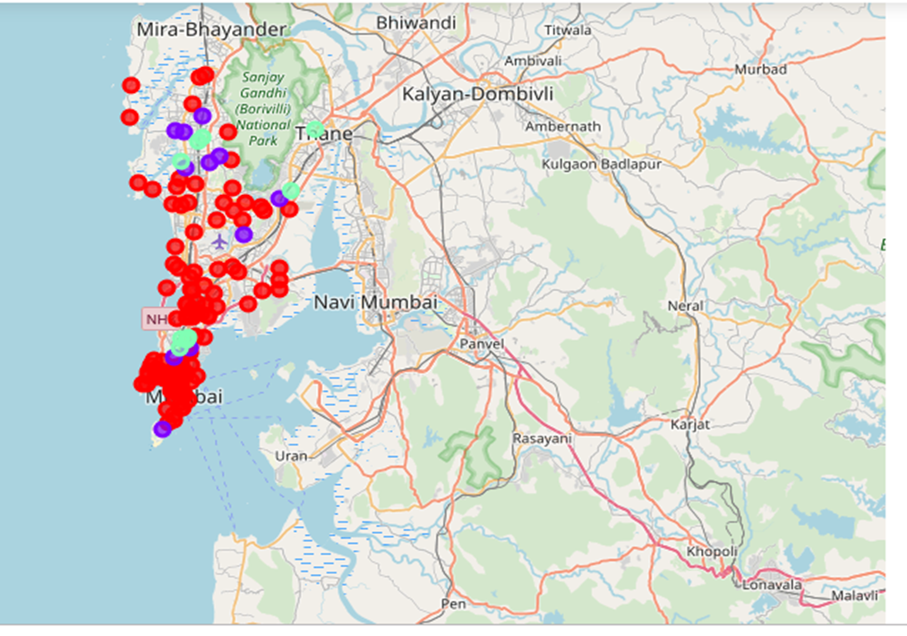
Results :
Categorized the neighbourhoods
into 3 clusters :
Cluster 0: Neighbourhoods with high
concentration number of shopping Centres
Cluster 1: Neighbourhoods with moderate
number to no existence of shopping centres
Cluster 2: Neighbourhoods with low
concentration of shopping Centres.

Slide 6
Discussion :
Most of the shopping Centers are concentrated in the central area of Mumbai city, with the highest number in cluster 0 and moderate number in cluster 1
This represents a great opportunity and high potential areas to open new shopping Center as there is very little to no competition from existing Shopping centers.
Therefore, this project recommends property developers to capitalize on these findings to open new shopping centers in neighborhoods in cluster 2 with little to no competition.
property developers are advised to avoid neighborhoods in cluster 0 which already have high concentration of shopping centres .

Slide 7
Recommendations :
This project recommends property developers to capitalize on these findings to open new shopping centers in neighborhoods in cluster 2 .
property developers are advised to avoid neighborhoods in cluster 0 which already have high concentration of shopping centres .

Slide 8
Conclusion :
To answer the business question that was raised in the introduction section, the answer proposed by this project is: The neighbourhoods in cluster 2 are the most preferred locations to open a new shopping centre.
The findings of this project will help the relevant stakeholders to capitalize on the opportunities on high potential locations .
Helps builders to avoiding overcrowded areas in their decisions to open a new shopping centre.

Slide 9


